Slide 1
Exhibitor Social Media Cards

Slide 2
Step 1: Follow Instructions
This template has been created for you as an exhibitor. Please follow the instructions within this Power Point to create your promotional social media card(s).
Insert logo and booth # here

Slide 3
Step 2: Replace Text
2. Select a card or several cards (next slides). You may also use any or all of these in different social posts.

Slide 4
<Insert logo and booth # here>

Slide 5
<Insert logo and booth # here>

Slide 6
<Insert logo and booth # here>

Slide 7
<Insert logo and booth # here>

Slide 8
Steps 3-4: How to Save the Image
3. Leave colors, font, and alignment as-is.
4. Once logo and text is in place, click on SAPPHIRE NOW and ASUG Annual Conference logo and then click the CTRL and A keys (this will select every text box within the image).

Slide 9
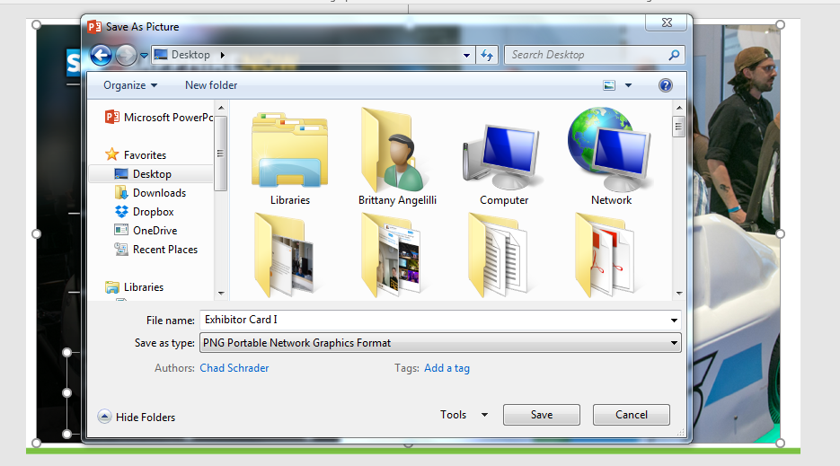
Steps 5-6: Saving the Image
5. Right click, select “Save as Picture.”
6. Save image to your computer in a space you can best locate.

Slide 10
Step 7: Share on Social
7. Share on social media. Use #SAPPHIRENOW and #ASUG2017 when sharing on Twitter and Facebook. Always @ASUG365 or @SAPPHIRENOW on Twitter
Your logo here

Slide 11
Follow Us
Thank you for your time
Follow us on
@ASUG365 and @SAPPHIRENOW

